Slide 1
Understanding Load Balancers
Scalability In System Design

Slide 2
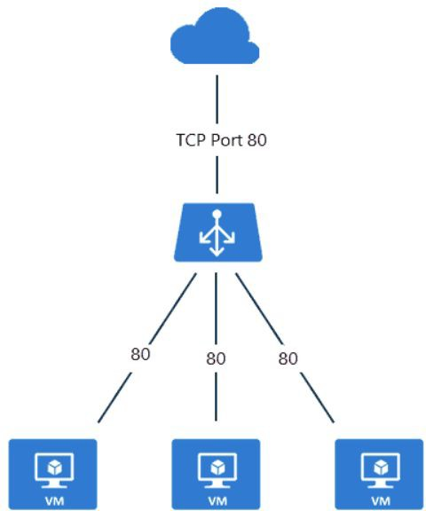
Why Load Balancing is Needed
High Availability: Ensures system uptime even under high traﬃc.
Traﬃc Distribution: Spreads requests evenly across servers.
Prevents Overload: Avoids overburdening a single server.
Improves Performance: Reduces latency and enhances response times.
Handles Failures Gracefully: Redirects traﬃc in case of server failure.
Supports Scalability: Helps scale systems eﬃciently.
Example: A high-traﬃc e-commerce site uses load balancing to handle peak-hour requests.

Slide 3
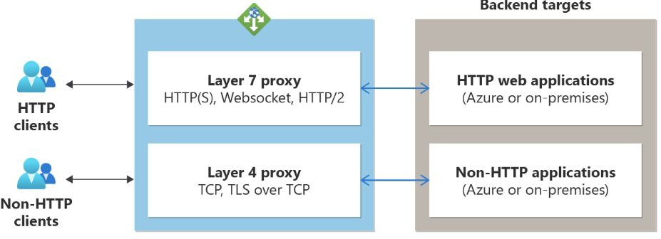
Types of Load Balancers
Based on Layer
  Layer 4 (Transport Layer): Operates at TCP/UDP level, distributing requests based on network-level data.
  Layer 7 (Application Layer): Operates at HTTP/HTTPS level, making routing decisions
based on request content.
Based on Deployment
  Hardware Load Balancers: Specialized devices (e.g., F5, Citrix NetScaler).
  Software Load Balancers: Nginx, HAProxy, Envoy.
  Cloud-based Load Balancers: AWS Elastic Load Balancer (ELB), Google Cloud Load Balancing.

Slide 4
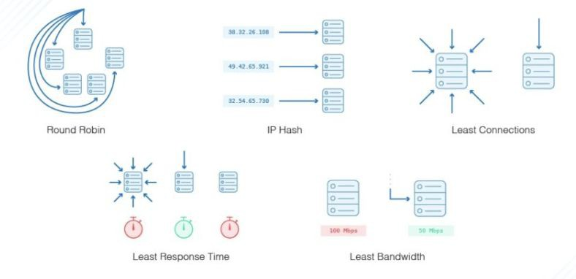
Load Balancing Strategies
Static Load Balancing
  Round Robin: Distributes requests sequentially to each server.
  Least Connections: Directs traﬃc to the
server with the fewest connections.
  IP Hashing: Routes requests based on client IP.
Dynamic Load Balancing
  Least Response Time: Sends requests to the server with the fastest response.
  Adaptive Load Balancing: Uses real-time
monitoring to make decisions.
  Weighted Load Balancing: Assigns diﬀerent weights to servers based on capacity.

Slide 5
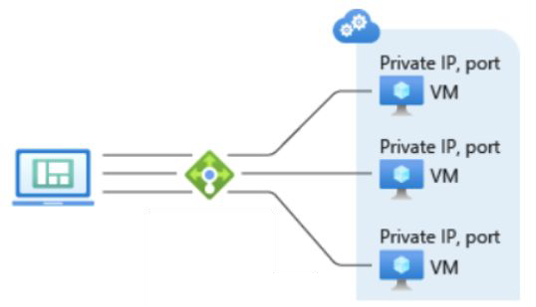
Load Balancer in Action
Example Scenario:
  A web application with multiple servers.
  Users send requests, and the load balancer distributes them eﬃciently.

Slide 6
Choosing the Right Load Balancer
Layer 4 vs. Layer 7: When to use each type.
Scalability Needs: Matching the right load balancer to traﬃc volume.
Security Concerns: SSL termination and DDoS protection.
Use Cases:
  Nginx/HAProxy for web applications.
  AWS ELB for cloud-native applications.
  Hardware Load Balancers for enterprise data centers.

Slide 7
Interview Questions on Load Balancing
Fundamentals
  What is load balancing, and why is it important?
  Explain the diﬀerence between Layer 4 and Layer 7 load balancing.
  How does a load balancer handle high availability and failover?
Strategies & Use Cases
  Compare Round Robin and Least Connections strategies.
  What are the advantages of Weighted Load Balancing?
  When would you use a software load balancer over a hardware one?
Real-World Scenarios
  How would you design a scalable load balancing solution for a large e-commerce site?
  What factors should be considered when choosing a load balancing strategy?
  How does a load balancer improve security?

Slide 8
Summary & Key Takeaways
Load balancing enhances scalability, reliability, and performance.
Diﬀerent types exist based on layers and deployment models.
Choosing the right strategy depends on traﬃc patterns and system needs.
Essential for highly available and resilient architectures.
What’s next:
  Autoscaling & Best Practices in Cloud Environments

